Slide 1
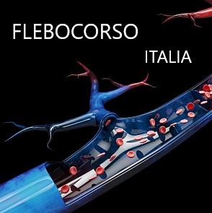
VENOSOUS DIAGNOSTICS €1000 Ecocolor Doppler venous, transillumination - Vascular anatomy and physiology (haemodynamics). - Superficial venous circulation. - Deep venous circulation. - CUS (ultrasonographic compression). - Venous thrombosis: Diagnosis with echocolour Doppler. - Heparin therapy and therapy with NAOs. - Elastocompression therapy. - Examination and reporting. - Setting up an outpatient venous diagnostics clinic. - Practical session in the outpatient clinic (3 hours).

